Slide 1
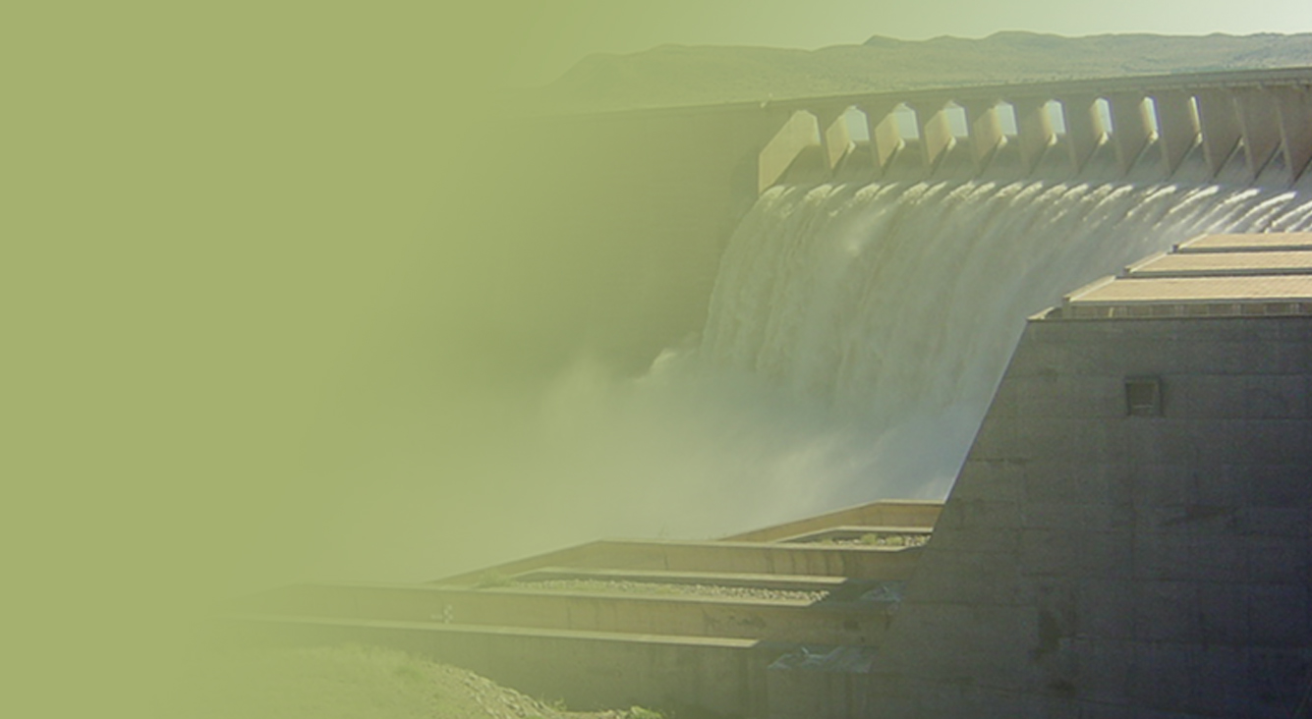
THE NATIONAL ROLL-OUT OF HYDRONET TO SUPPORT SOUTH AFRICA’S CATCHMENT MANAGEMENT AGENCIES
Presented by:
Name: Eustathia Bofilatos
Designation: Act CD: Water Institutions Management
Date: May 2022
PRESENTATION TITLE
Presented by:
Name Surname
Directorate
Date

Slide 2
CONTENTS
Background on Catchment Management Agencies
Applications of HydroNET
Current Status
Recommendations

Slide 3
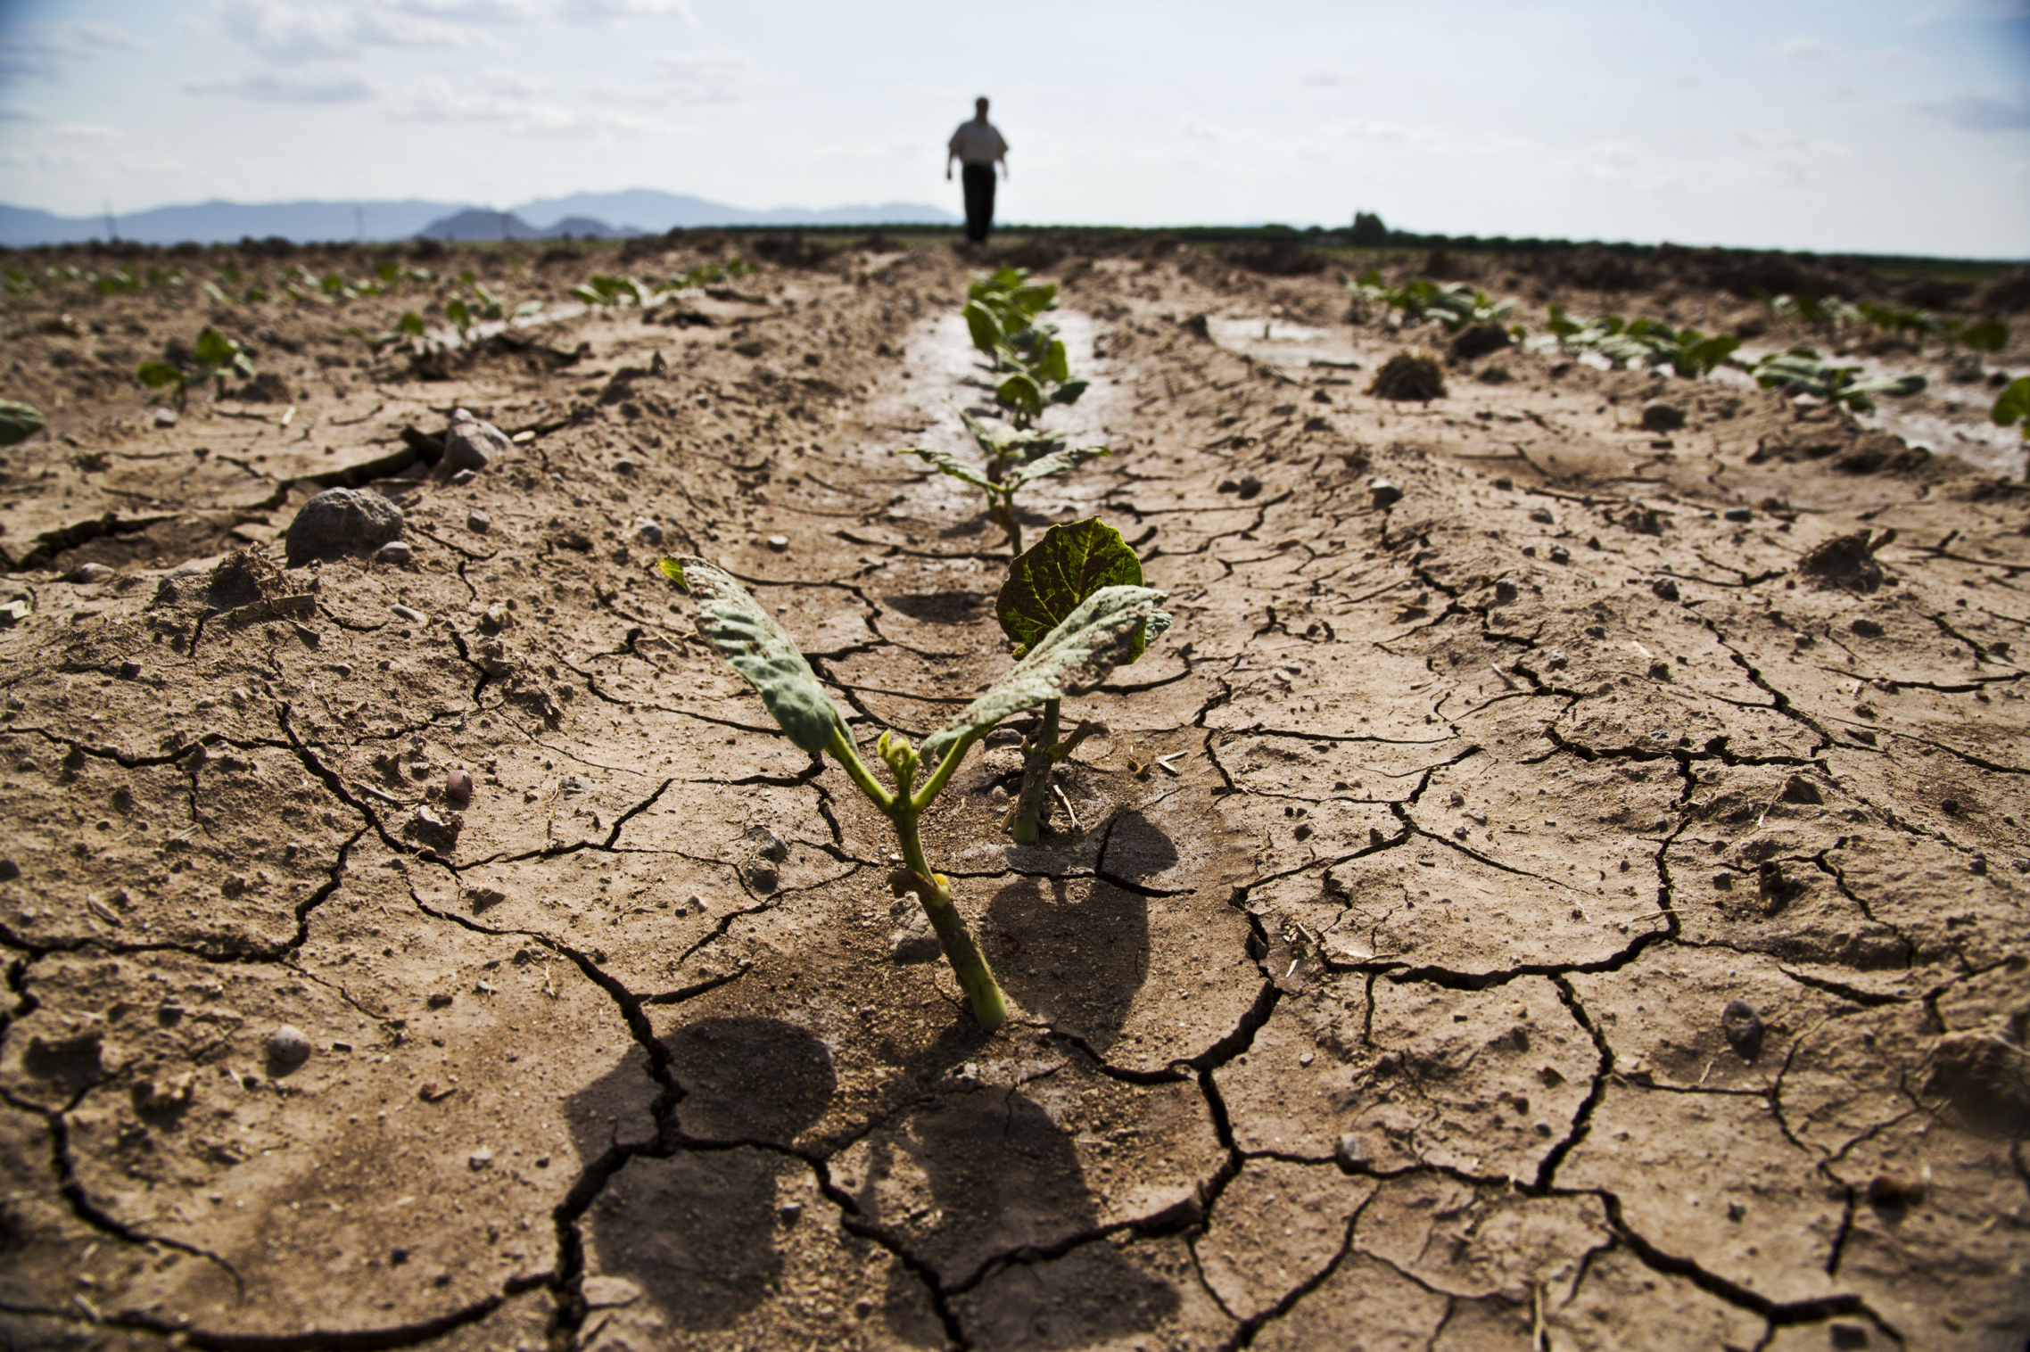
Water challenges: Recent floods in February and April in Tshwane and KZN respectively many people forced to leave their homes – infrastructure
Water challenges: Hugh water losses - non revenue water (physical leakage or commercial loss) >35%
Water stressed catchments with over allocations or illegal water use
Poor audit and compliance of water use
Water quality problems which affects
Industries such as Agriculture, Water management
Need for decision support tools to identify priority areas
Need for reliable information
Rainfall/evaporation/water use/water quality

Slide 4
CATCHMENT MANAGEMENT AGENCIES
The National Water Act, 1998 (Act No. 36 of 1998) provide for the establishment of Catchment Management Agencies (CMAs) to facilitate the delegation of water resources management to a water management area (WMA) level.
The National Water Policy for South Africa provide for the establishment of CMAs with the aim of them being developmental in nature and to serve the interests of equity, corrective action and optimum use of water.
Key mandate of the CMA is to undertake WRM to achieve the following
Meet basic human needs
Promote equitable access to water
Redress results of past racial and gender discrimination
Facilitate social and economic development
Their main function is to monitor water quality and quantity , allocate water, set the tariffs, develop catchment management strategy,

Slide 5
BACKGROUND ON THE ESTABLISHMENT OF CMAs
Originally, 19 CMAs were envisaged but this number was rationalised to nine by then Minister in March 2012. Of these, six have been established to date (the Inkomati-Usuthu, Breede-Gouritz, Pongola-Umzimkulu, Limpopo-North West, Vaal and Olifants CMAs), of which only the first two are operational.
In 2013, the Presidential Review Committee on State-owned Entities recommended the consolidation and rationalisation of entities wherever possible.
The DWS review of the institutional arrangements for water resource management in 2017 culminated in the gazetting for public comment a proposal to establish a single national entity.
In 2018 a decision was made by then former Minister to revert to the establishment of nine separate CMAs.
In 2019, a case for reducing the number of CMAs from 9 to 6 was made and approved by the former Minister in 2020

Slide 6
CURRENT STATUS ON THE ESTABLISHMENT OF CMAs
The National Water and Sanitation Master Plan, launched in Nov 2019; has prioritised the establishment of CMAs, and the progressive delegation or assignment of powers, functions and duties CMA.
CMA establishment has demanded attention be given to any opportunities for reducing costs and increasing efficiencies, without compromising on the core objectives of decentralising water resource management.
After a series of engagements with the Ministerial Committee and the relevant Branches, a position to re-align the water management areas was approved by the former Minister
Notes:
Operational Integration
Connected and integrated water systems
Easy coordination and monitoring of agreements
Improved capacity – pooled technical skills
Integrated water resource planning
The river basins fall within the same water system
Improved resource planning
Transboundary systems managed by same conventions
Economies of scale
Enhance revenue and hence sustainability
Cost – effectiveness
Consolidate management structures

Slide 7
MAIN PRINCIPLES IN REALIGNING THE WMA AND RESPECTIVELY THE CMAS FROM 9 TO 6 ARE:
Operational Integration
Connected and integrated water systems
Easy coordination and monitoring of agreements
Improved capacity-pooled technical skills
Integrated water resource planning
The river basins fall within the same water system
Improved resource planning
Transboundary systems managed by same conventions
Economies of scale
Enhance revenue and hence sustainability
Cost – effectiveness
Consolidate management structures

Slide 8
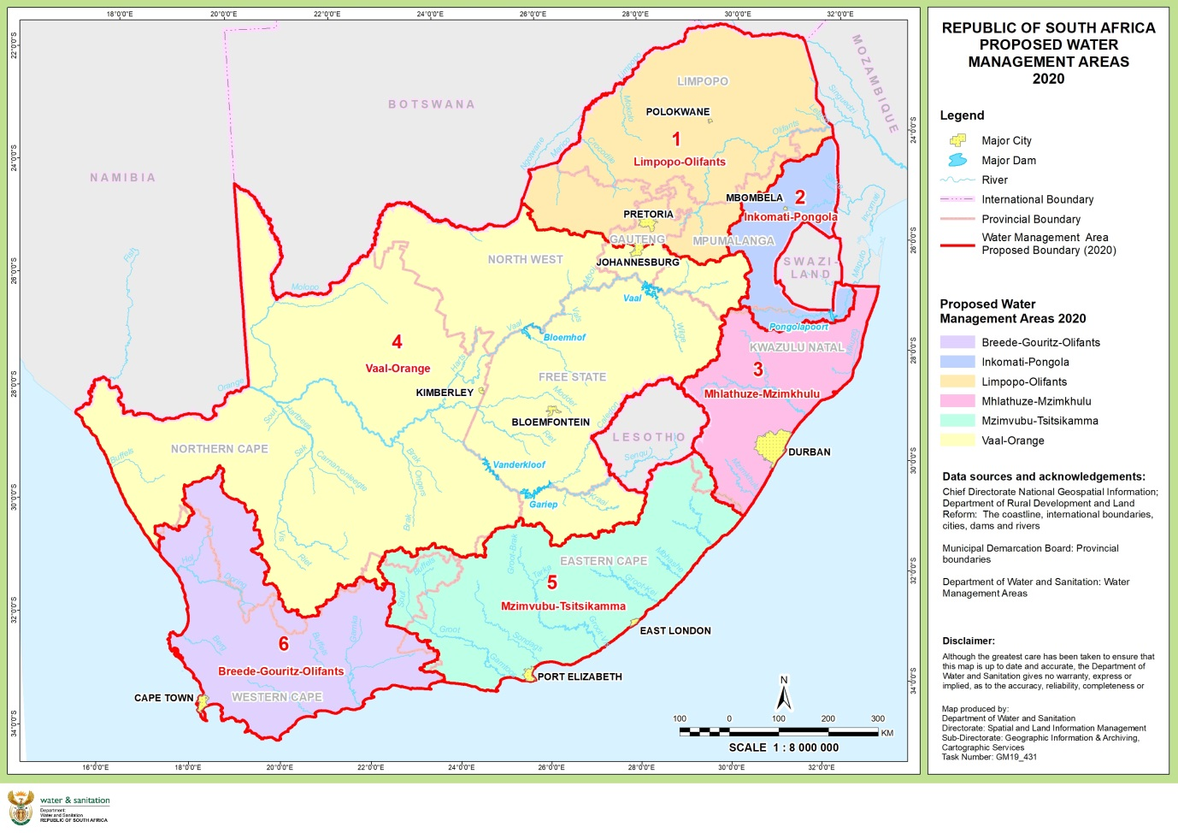
WATER MANAGEMENT AREAS

Slide 9
APPLICATION OF HYDRONET
The Department of Water and Sanitation is the custodian of water resources in South Africa and conforms to the National Water Act (NWA) in ensuring water resource management.
The NWA particularly section 16 of the Act provides that the Department should provide for the Reserve determination or resource quality objectives of a catchment area. The importance of having reliable data that can improve decision making by water managers in South Africa configured specifically for their individual needs within their water management areas is critical in IWRM.
South Africa and the Netherlands have a long-standing relationship, first in the Kingfisher project and subsequently in the Blue Deal programme
In 2013, the Inkomati Usuthu Catchment Management Agency, South African Weather Services and the Hydrologic cooperated to develop a set of tailored applications for Catchment Management Agencies- the HydroNET Water Control Room starter’s package.

Slide 10
APPLICATION OF HYDRONET (CONT)
HydroNET is a web-based decision support service that provides intelligent solutions for operational and strategic water management. The application provides the CMAs with easy access to a wealth of essential hydrological and meteorological data.
In 2016, the Department adopted the roll out of the HydroNET system to all water management areas in South Africa.
The Department of Water and Sanitation contracted the South African Weather Services as the sole provider of the HydroNET in November 2021
The system allows water professionals to make well informed decisions and information to be shared with relevant stakeholders.

Slide 11
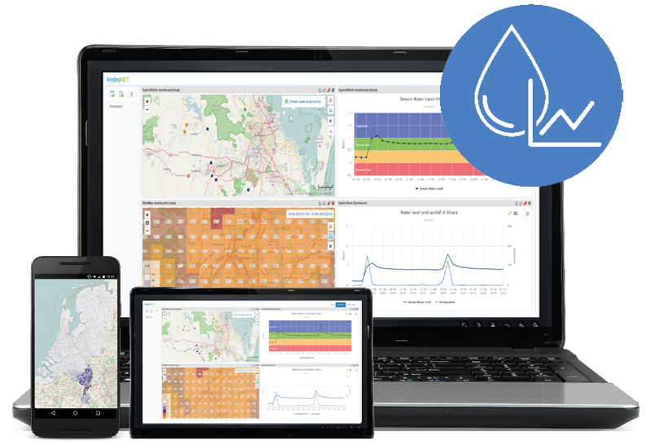
RESULT OF DEMONSTRATION PROJECT: HYDRONET TOOLBOX FOR CMAS
Live access to water quantity and quality data
Status (STEEP) KPI’s of CMS
Water use data compared with allocation
Automated situational reports for stakeholders
All dashboards and tools available online
Weather and Climate Information from SAWS
Situational dashboards per colleague /situation
Export Weather information to models
Notes:
Additional functionalies

Slide 12
APPLICATIONS OF THE HYDRONET
Source: https://www.hydronet.co.za/

Slide 13
BENEFITS OF HYDRONET FOR WMAS
Improved WeatherSMART water management decisions
Insight in weather and climate information
Insight in water use
Insight in water availability
Improved accountability and transparency
Improved insight in sources of pollution
Automated reports for stakeholders
Insight into status of KPI’s for adaptive water management

Slide 14
CURRENT STATUS
Training has taken place in all water management areas
Planning HydroNET Launch event dated 4 May 2022 at the IUCMA, Nelspruit in Mpumalanga
Appointed National Steering Committee in March 2022 that provides an oversight function to ensure successful outcome of the project.
The committee includes various stakeholders within the Department, SAWS, HydroLogic, Young Water Professionals, Water Research Commission.

Slide 15
RECOMMENDATIONS
Ensure that hydroNET is aligned to DWS systems such as NIWIS
HydroNet Training progamme to be adhered to
Through the training and use of HydroNET ensure sustainability into the future
The value add that hydroNet provides should ensure that it markets itself – however we as users should take the opportunity to demonstrate its benefits

Slide 16
Thank You

